Slide 1

DOORMED
TEAM MEMBERS:
SI. No | Name | Roll Number
1 | AMIT KUMAR | 205120015
2 | NIKITA DAS | 205120062
3 | ANSHU MALA LAKRA | 205120019
4 | POOJA YADAV | 205120072
5 | MAYANK KUMAR SINGH | 205120051

Slide 2
INTRODUCTION TO IDEA
Our idea is “DoorMed” where “Door” means Door and “Med” means Medicines.
So basically in this we are going to deliver medicines at the door of the customer within a reasonable time.
We have two different sections ::
SELLER | CUSTOMER
Sellers can add their available medicines in their section of our website . | Customers can check the availability of required medicine in their section and can place the order.

Slide 3

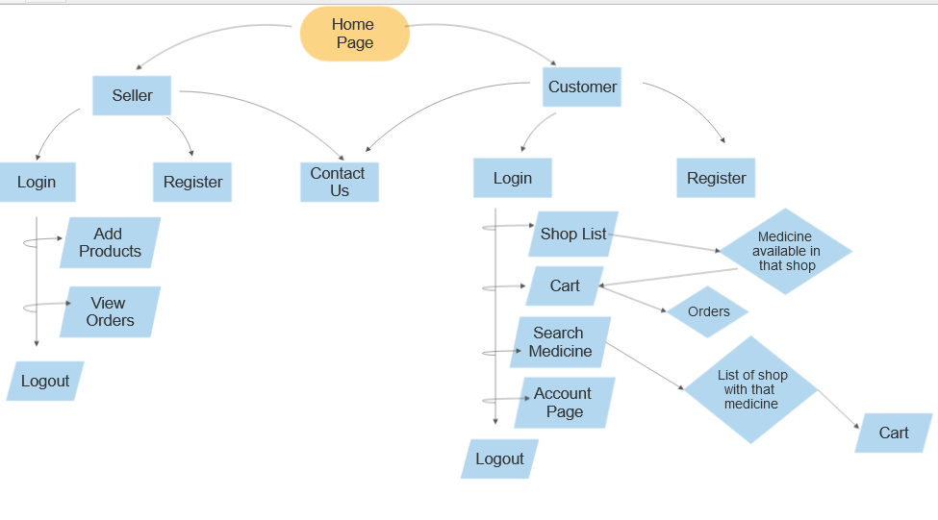
FLOWCHART

Slide 4
NEED OF THE START-UP IDEA
As we all know start-up come up with a solution of the modern existing problem.
So here we are with solution of ordering medicine not only in remote city but also in local area.
It will be a great contribution in advancement of E-commerce platform.
Support for local customers especially during this COVID-19 pandemic.
Profitable for both customers and local pharmacist .

Slide 5
OBJECTIVE
To provide the customers with facility of online delivery of medicines at their door-step like food, clothes, etc.
To provide support for the people who can’t travel 3-4 km to purchase medicines.
To provide support for customers during any pandemic like COVID-19.
To help out people who are in an situation of emergency or ill and can’t go out but need medicine urgently.

Slide 6
TECHNOLOGIES USED
Tool: Visual Studio Code
Language Used: PYTHON
Framework: FLASK
Web Technologies Used: HTML, CSS, JS

Slide 7
FUTURE SCOPE
Connect with maximum possible local pharmacists so that they can also develop and expand their business.
Create delivery chain starting from some local cities.
It can be expanded to almost all cities in India later.

